Slide 1

EDITH
A VIRTUAL ASSISTANT
Theme based project by
Chitturi Sai Suman - 097
Praneeth Kapila - 116

Slide 2
Problem Statement
People today are living the busiest life. While managing lot of activities, they keep forgetting things. They find it difficult to plan and manage activities. Moreover, under such lifestyle, they are not having enough access to immediate Entertainment.
This creates a need for a Virtual Assistant. Virtual Assistants, today, are capable of planning activities, setting reminders, alarms, playing music, telling jokes and facts etc.

Slide 3
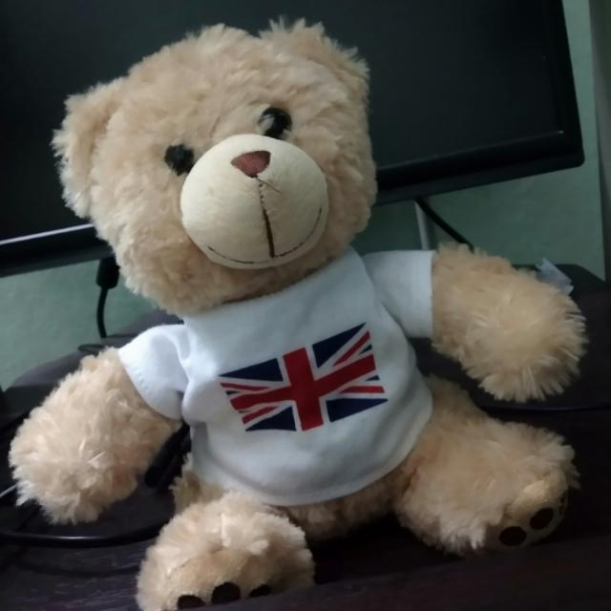
Proposed Solution
To Solve these problems, we would like to build a Virtual Assistant (Edith) which is capable of planning activities, setting reminders, alarms, playing music, telling jokes and facts etc.
Considering the portability issues, Edith is modeled as a Toy which can be easily carried and used. The assistant gets activated on squeezing the toy.

Slide 4



Functionalities
Voice based Activation
Voice Interaction
Set Reminders
Play Music
Schedule activities
Real time updates – Weather, Traffic, Game Scores
Entertainment – Facts, Jokes etc

Slide 5
Uniqueness
Can send Audio Messages
Notifications for Emails
Portability
Easy Maintenance

Slide 6
Relevance to Current World
Can save time and effort
Helps in churning through all the mounting undone work.
Gives the time to accomplish the things for which people never had time for
Keeps detailed track not only of how much time is being worked, but also what is being worked on

Slide 7
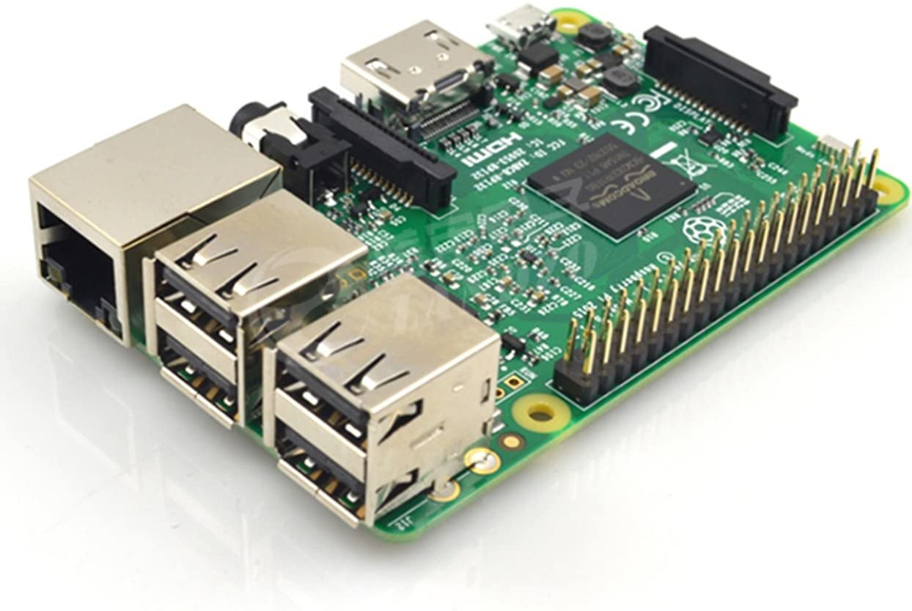



Components Required
Raspberry Pi 3
Microphone
Speaker
Interfacing Cables – VGA/HDMI, Ethernet, Jumper cables etc.

Slide 8
Thank You

